Slide 1
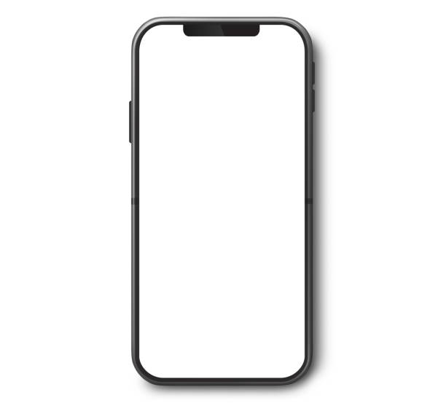
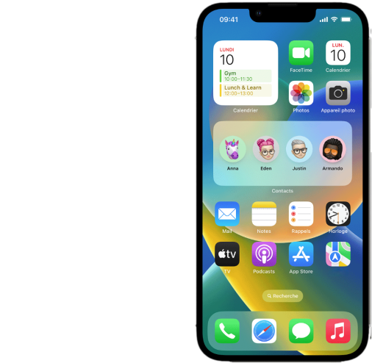

Fisherman
Application logo

Slide 2

Fisherman
Loading page

Slide 3



Fisherman
New Take
New Place
Main page

Slide 4




Fisherman
Accueil
My Place
My Places
Contact
Side menu

Slide 5
Fisherman
Contact
For any request please contact :
+xx-x-xx-xx-xx
Mail :
dummymail@gmail.com
Contact page

Slide 6

Fisherman
Shots searching
My Shots
date
Text to insert
Text to insert
Text to insert
Text to insert
Text to insert
Text to insert
Text to insert
date
Text to insert
Shots details
Text to insert
Text to insert
Add a shot
Shot page

Slide 7
Fulfilled by the users 10 caracters limit
Fisherman
My Shots
08/03/2024
Text to insert
Pressure
Temperature
Montage
Bait
Fulfilled by the users 30 caracters limit
On 2 line
Wind
Place

Slide 8

OPTION 1
Fisherman
My Places

Slide 9
OPTION 2
Fisherman
Place searching
MyPlace
date
Text to insert
Text to insert
Text to insert
Text to insert
Text to insert
Text to insert
Text to insert
date
Text to insert
place details
Text to insert
Text to insert
Add a place
Place page
Options 2

Slide 10
OPTION 2
Fisherman
MyPlace
10/11/2023
Text to insert
Country
Fulfilled by the users 30 caracters limit
On 2 line
Region
Name of the lake
Place page
Options 2

Slide 11
Loading page
Side menu
Contact
Main page
Shot page
Shot detail
Unidirectionnal access
“State machine”
Of the App for the shot
Bidirectionnal access

Slide 12
Place detail
Place page
Loading page
Side menu
Contact
Main page
Unidirectionnal access
Bidirectionnal access
“State machine”
Of the App for the place
If options 2 is selected

